Slide 1
2025 Internal Comms
Annual Recap

Slide 2
Internal Email Consolidation – 2024 vs 2025
111
We prioritized consolidating emails this year and making the more concise
Our Word Around Town houses several past weekly communications, such as anniversary milestones, new hires and internal opportunities
109
75
2

Slide 3
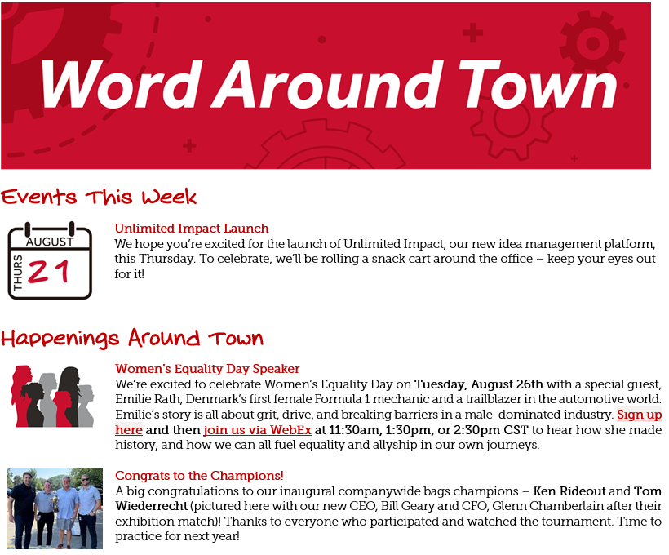
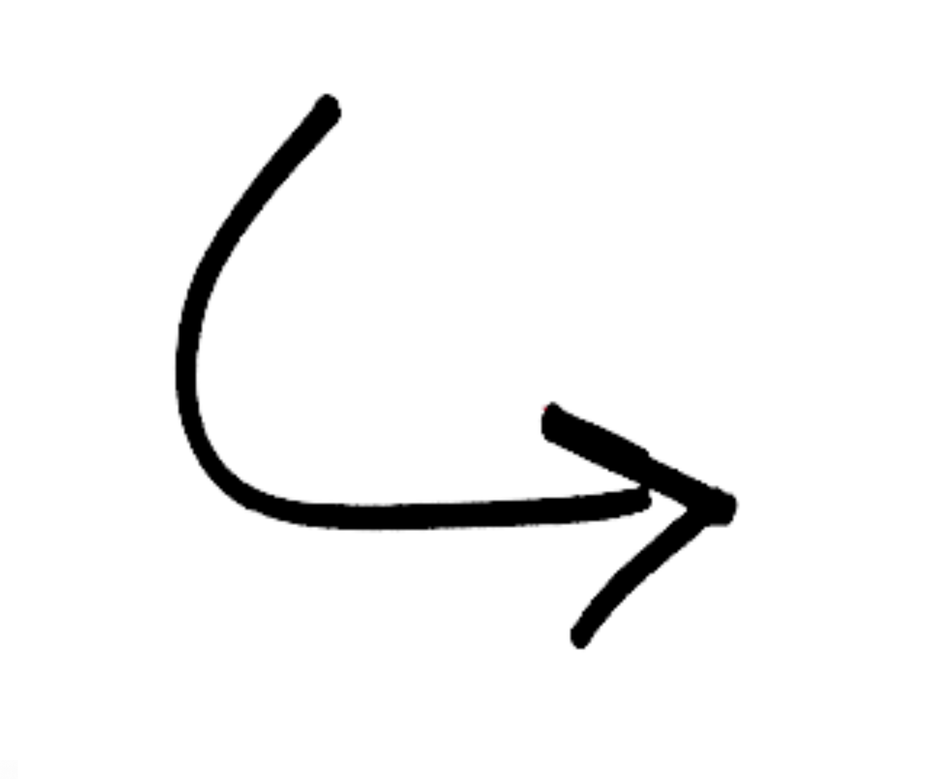
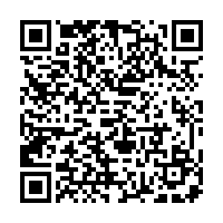
The Weekly Word Around Town
First edition launched February 3rd - just over 50 editions sent out so far
Separated by location so you’re only seeing what you need
Past editions stored conveniently in our communications library to look back on
3

Slide 4
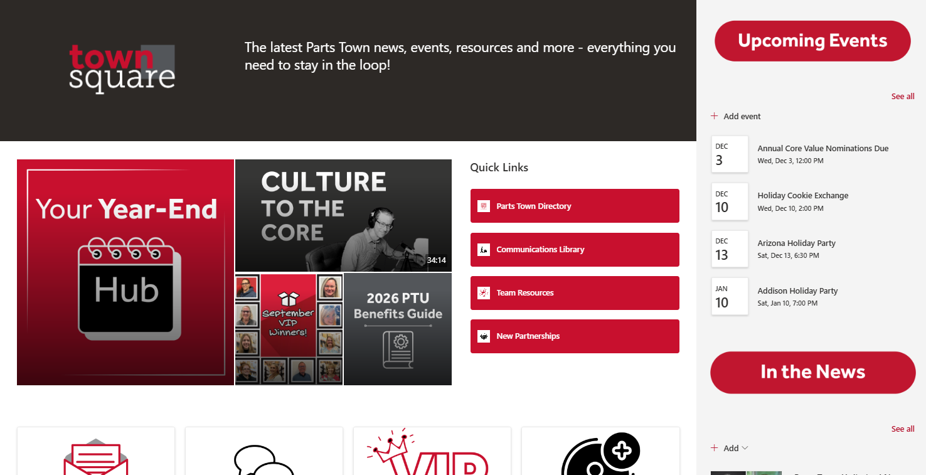
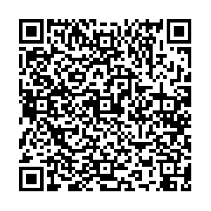
Town Square
Launched on April 29th, effectively replacing Parts of the Town
Since then, it’s had 1,251 unique viewers and 45,458 total site visits*
Viewership tends to peak Monday afternoon (aligning with weekly Word Around Town release)
We’re working on additional team and perk-specific pages
If you haven’t checked it out (shame on you), do it here
*as of 12/2/25
4

Slide 5

Town Square Performance
816
723
Town Square’s have been on an upward protectory.
As in past years with Parts of the Town, Open Enrollment and Year-End Checklist season brought more viewers than past months.
579
569
600
543
533
466
377
5

Slide 6
Town Square Performance
As with unique views, total views of Town Square have grown for the most part each month.
November and December each got a bump in traffic courtesy of the Year-End Hub.
6

Slide 7
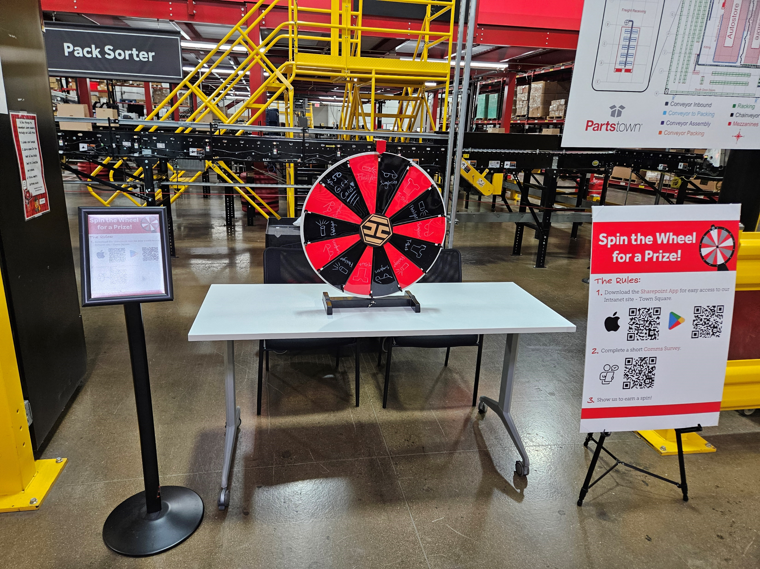
GFC Outreach
Internal communication can be trickier in our Fulfillment Center, as GFC team members don’t sit at a computer
We had an outreach day in July, surveying how team members prefer receiving PT news and urging SharePoint app downloads for easy Town Square access
  112 GFC team members downloaded the app on their phone
  We received feedback that 59% of GFC team members prefer emails, 51% text messages, 26% huddles
7

Slide 8
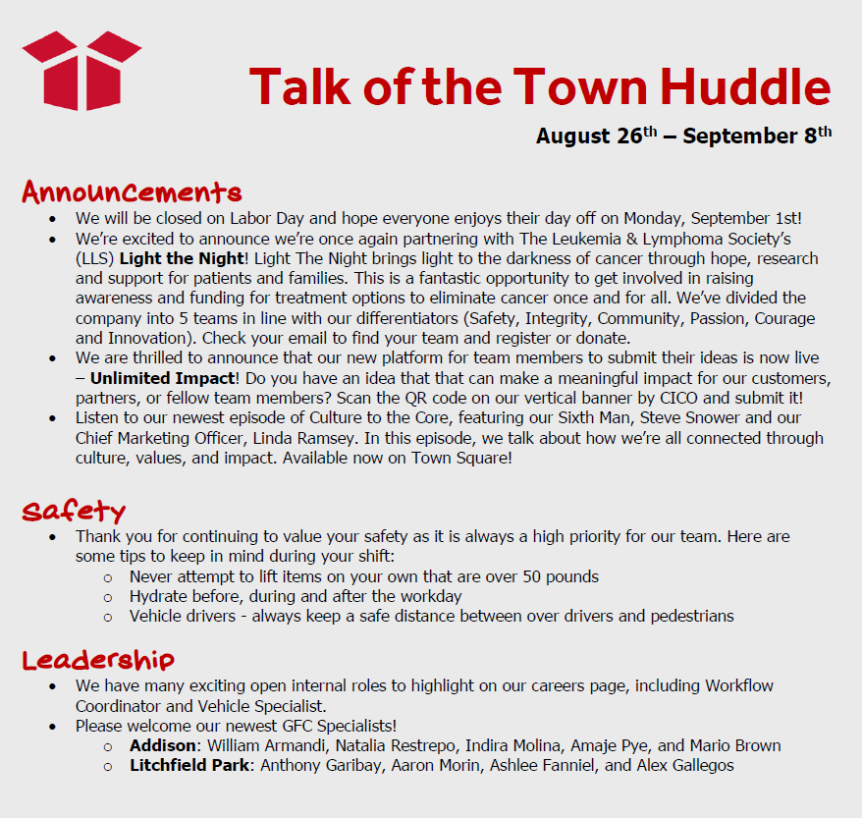
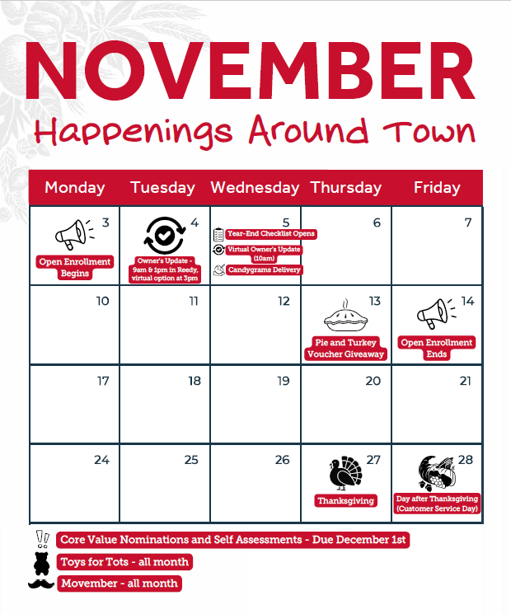
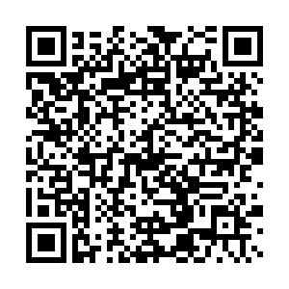
Huddle and Happenings
Happening calendars are hung up around the offices in the first week of each month
Each location’s calendar is a bit different depending on in-office activities.
Addison’s calendars from past months can be found on Town Square
GFC team leaders read our Huddle every 2 weeks to their teams to update them on around the town happenings. Most content is pulled from the previous or upcoming Word Around Town.
8

Slide 9
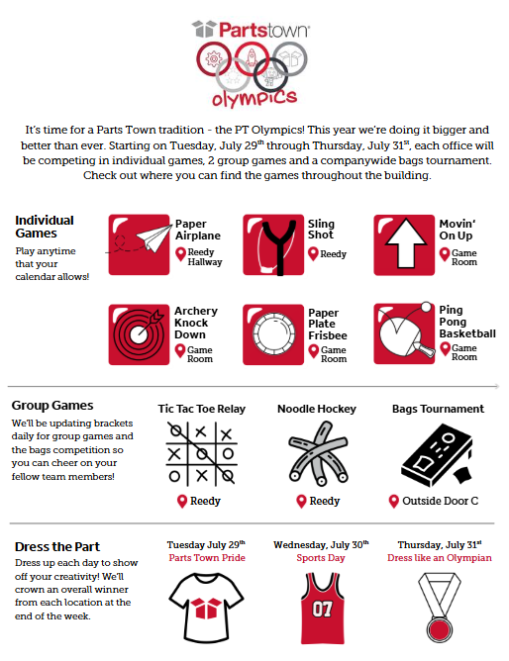
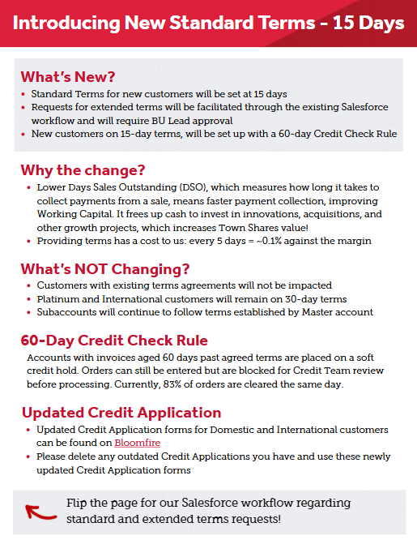
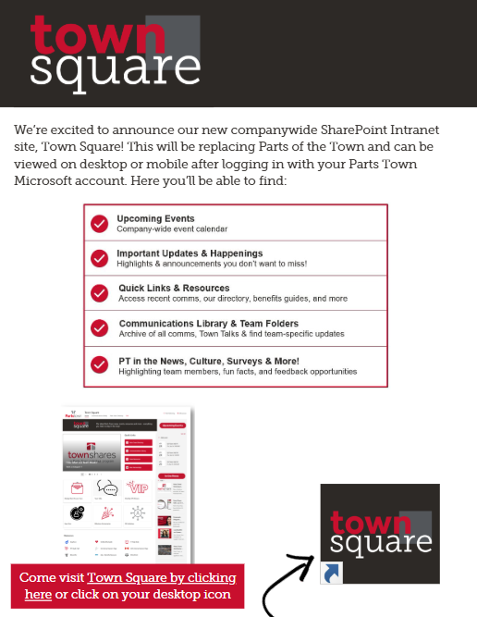
Desk Drops
Desk Drops continue to be an important way to bring attention to a big project, culture event or initiative
We’ve partnered with several teams this year to create companywide desk drops as well as team-specific desk drops
9

Slide 10
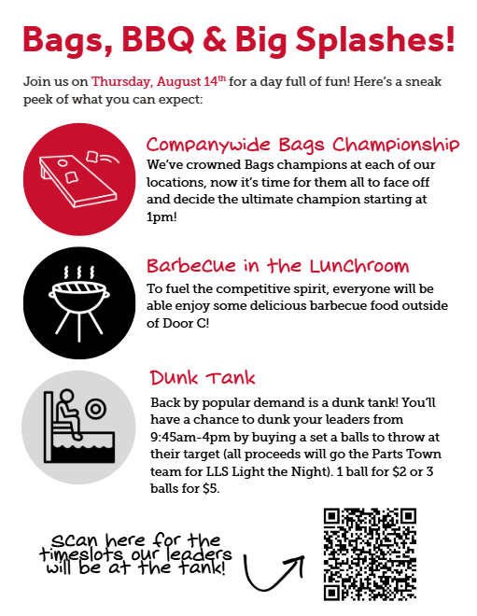

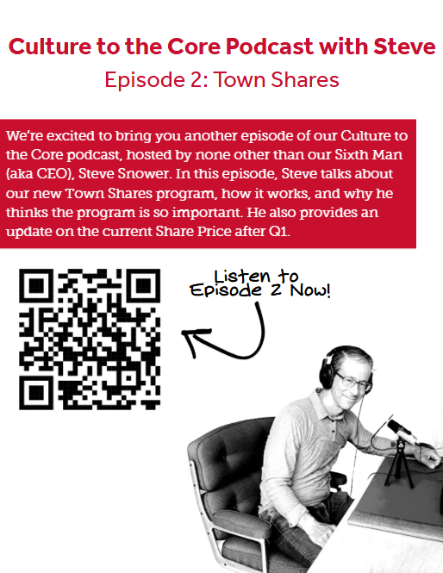
Flyers
We still post flyers frequently in our GFC, lunchroom and restrooms for culture events and time-sensitive events
We’ve round metrics haven’t been great for our flyers so we don’t rely on them as the primary source of communication
10

